Slide 1

Vaccination and worming for cat

Slide 2
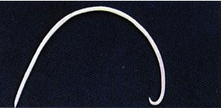
Worming:
Three different types of worms cat experiences
Roundworm
Hookworm
tapeworm

Slide 3
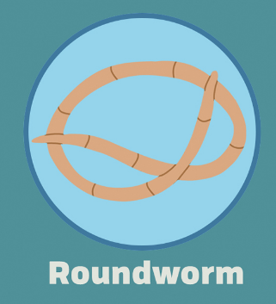
Roundworm
happens most common for kittens before 8 weeks, treat it every three weeks with medications is enough

Slide 4

Hookworm:
Not as common, can be infected by eating its eggs, treatable with medicines, make sure you filter the cats diet to prevent its infection

Slide 5

Tapeworm
happens most common for cats older than six month, just like roundworm, it is advised to treat cat with medications for both roundworm and tapeworm every three weeks.

Slide 6
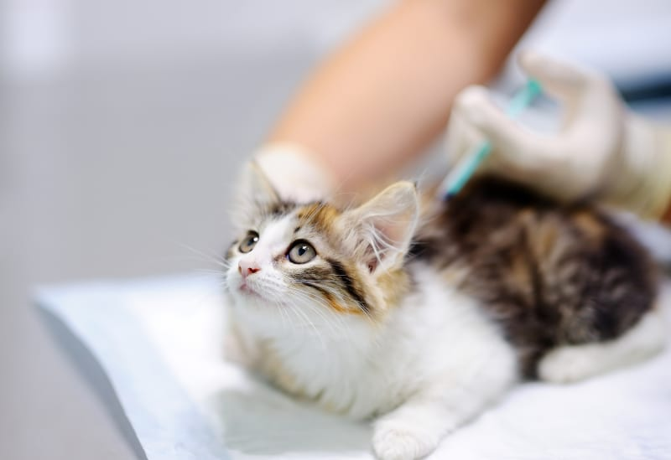
Vaccination procedures
Two types of mandatory vaccine:
Core vaccines: essential vaccines every cat needs to prevent it from having the most common disease
Rabies

Slide 7
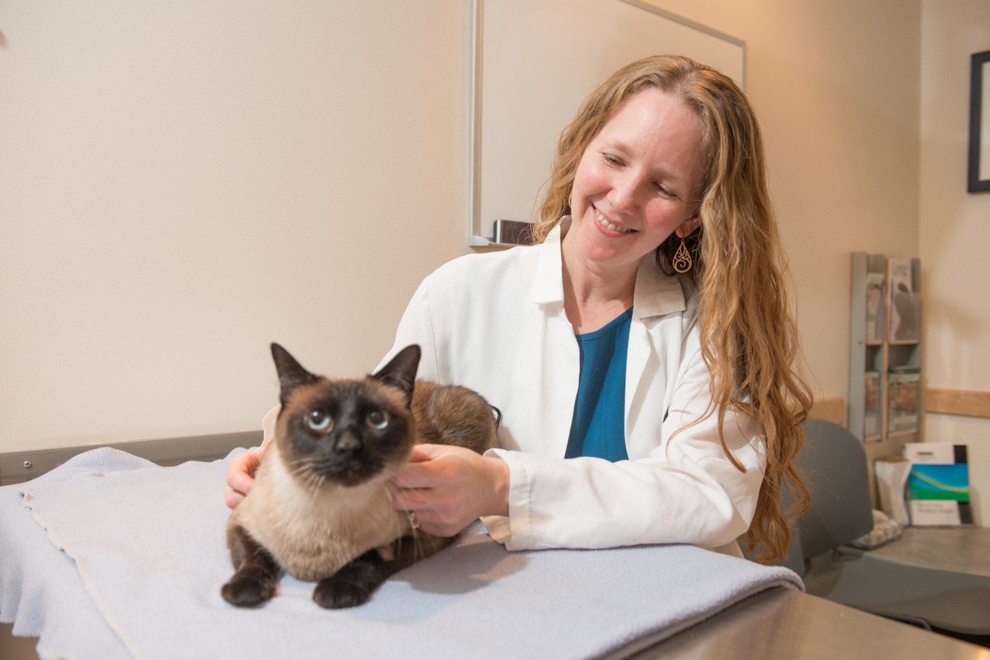
Vaccination procedures
These vaccine doses are given in a span of three visits along with other health checks
First visit: nutrition and grooming
Second visit: examination of parasite
Third visit: rabies

Slide 8

Conclusion
Different care procedures needs to be given to cat at different stages
Go to the doctors to check periodically to see if there are any new things to be monitored

