Slide 1

How to pet a cat?
EDCI 337
Zhuoheng Liu (Shone)
Notes:
Hi everyone! Today my presentation topic is how to pet a cat.
The purpose of this presentation is to provide clear instructions on how to pet a cat so that you can learn how to approach and touch almost any cat without stressing the animal out.

Slide 2

Introduction
How many you have cats at home, how many of you enjoy your cats’ purring?
How many of you cannot resist the desire to pet a cat as soon as they see one?
How many of you have been scratched by a cat when you wanted to pet him?
Notes:
So, how many you have cats at home, how many of you enjoy your cats’ purring? How many of you cannot resist the desire to pet a cat as soon as they see one? How many of you have been scratched by a cat when you wanted to pet him?

Slide 3
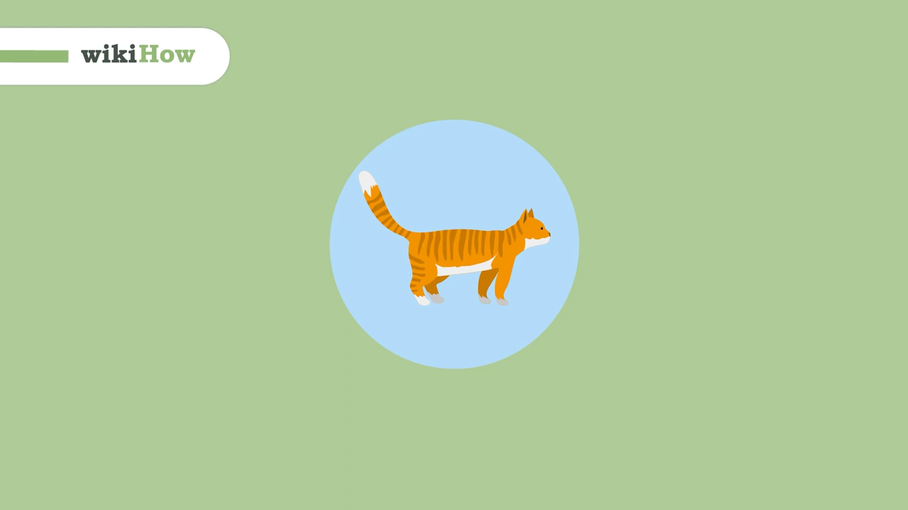
Guide From wikiHow
Notes:
Start to learn how to pet a cat with this guide from wikiHow.

Slide 4
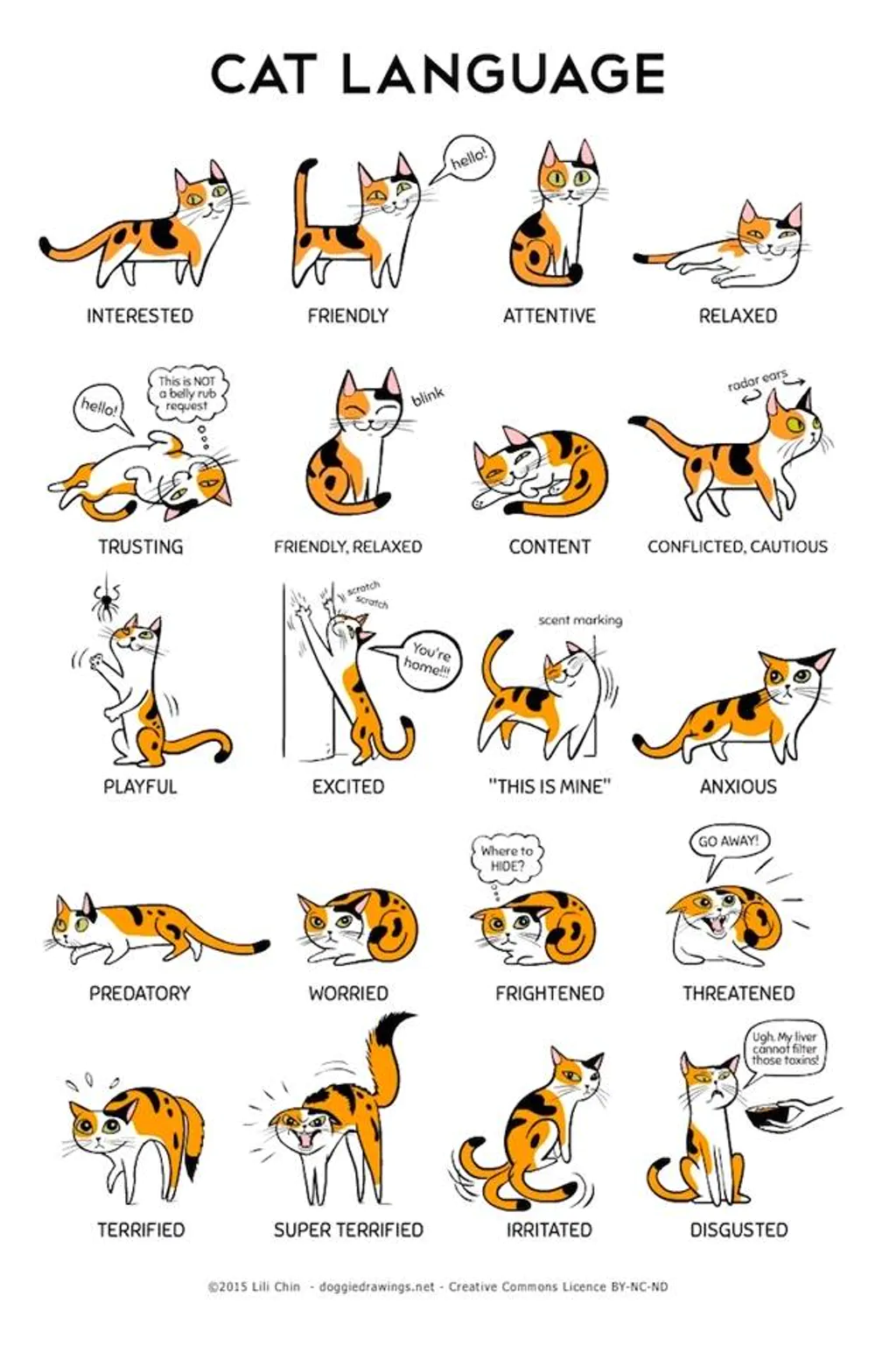
Main Steps
Approach a cat
Recognize the signals
Pet!
Notes:
- The main points of this presentation is: 1. approach a cat; 2. recognize their signals; 3. go pet!

Slide 5
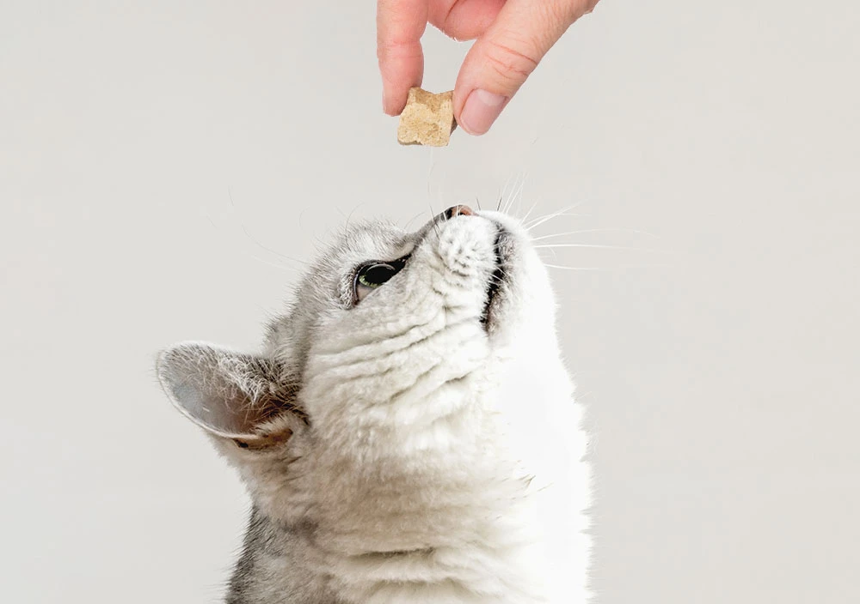

Approach a cat
Call him friendly
Interest him and win his attention and trust
Stretch a hand (or fingers)
Notes:
- How to approach a cat? Firstly, call him friendly. Secondly, interest him and win his attention and trust. Thirdly, stretch a hand or fingers.
- Having a cat close to you, you can proceed to the next step.

Slide 6
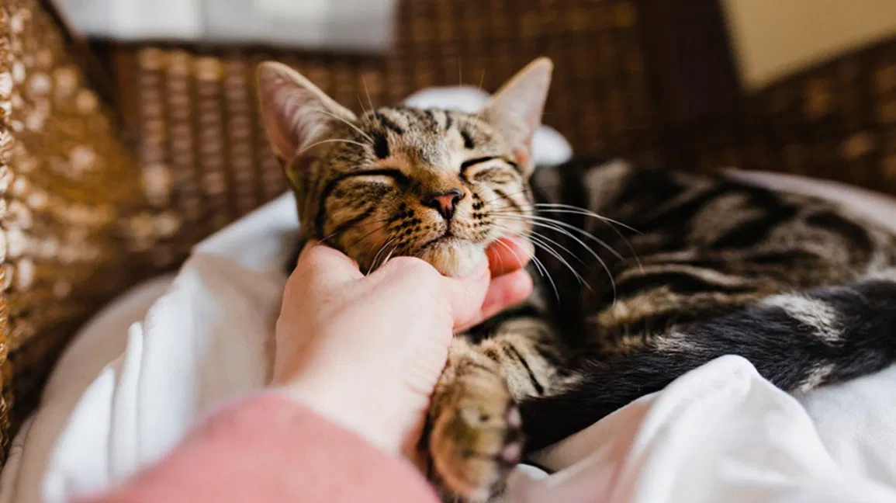
Recognize the signals
Approach him later
Softly touch him
Start with rubbing the cat’s face
Notes:
- Recognizing the signals of cats are important. When a cat shows no interest or steps back, you can try to approach him later. If a cat moves closer and sniffs you, you can now softly touch him. Start with rubbing the cat’s face, especially the chin, cheeks, and ears.
- If the signals a cat showed you are good, you can move on to the next step.

Slide 7
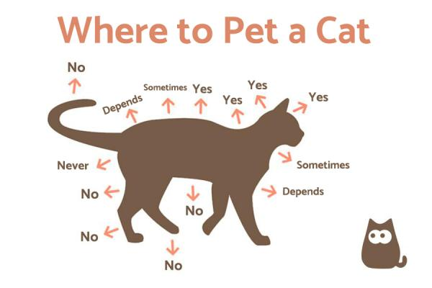
Pet!
Pet from the head to tail
Slow, gentle, and repeated moves
Avoid belly, tail, and feet touched
Notes:
- It is time to pet! Pet cats from the head to tail. And remember about slow, gentle, and repeated moves
Cats generally do not like their belly, tail, and feet touched, so avoid these areas.
- As we have finished, let us go to recall key moments we have talked about.

Slide 8

CONCLUSION
Approach a cat (be sure to introduce yourself to a cat)
Recognize the signals (be certain to follow them up)
Pet! (Be careful to pet in the same direction gently)
Notes:
The presentation was aimed to teach anyone how to pet a cat so that you can approach and touch a cat in a prover way and not make him stressed.

Slide 9
Thank you!
Notes:
I do hope that everyone enjoyed today’s presentation and discovered something new and exciting for themselves. I also believe that the right strategy of petting a cat will satisfy both a human and an animal, so I want to inspire you to find the right approach to every cat and keep in mind that every cat is an individual.

